Slide 1


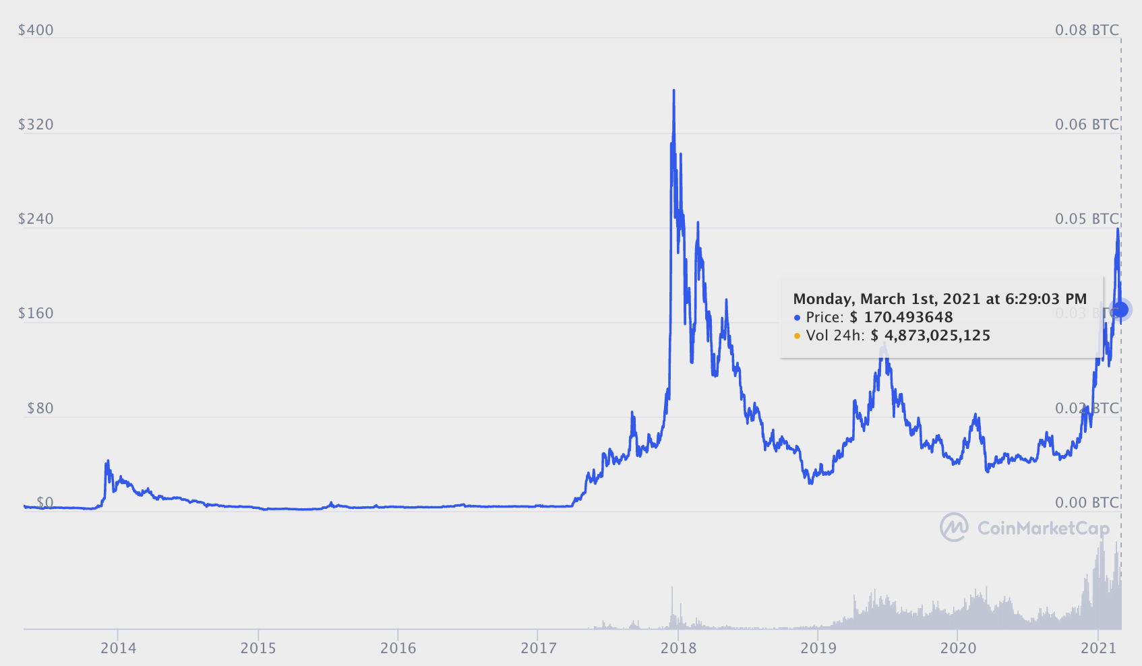
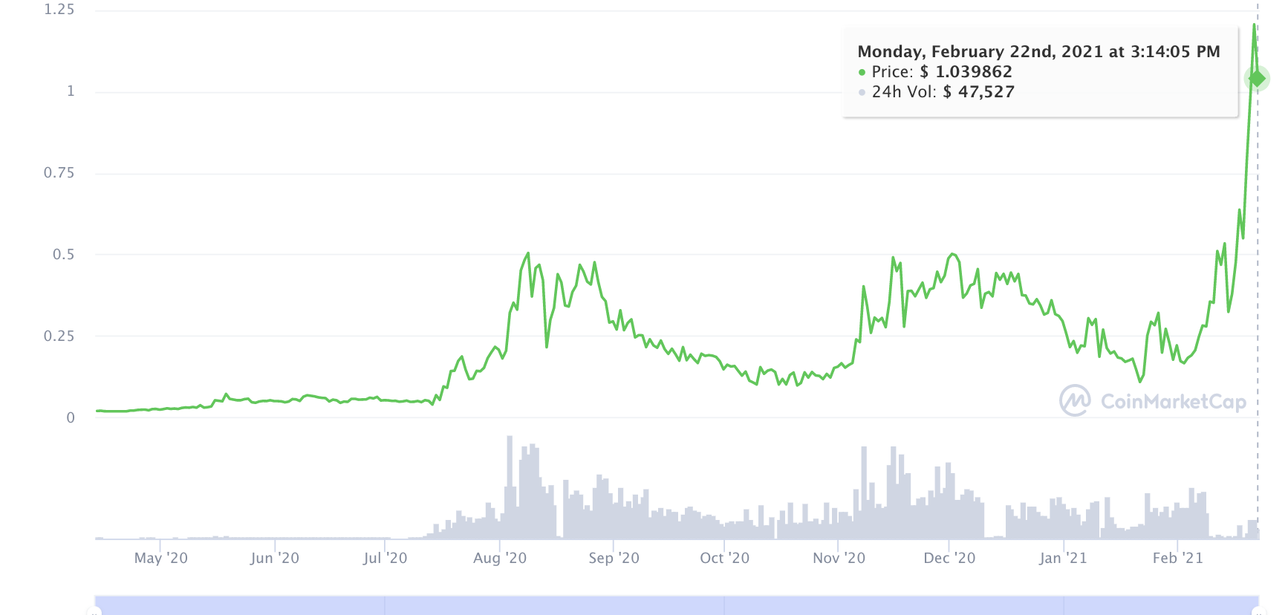
CRYPTO SILVER
THE RACE TO BE A MEDIUM OF EXCHANGE
CURRENT SUPPLY
66.6m
10.6M
MAX SUPPLY
84M
21M
PRICE
$171.29
$1.03
MARKET CAP
CHART?
SPEED
2.5 minute
block interval
1 minute
block interval
FEE
3 cents / tx
$.00025
40 transactions
for 1 cent
Can validate entire chain on low-end smartphone
SCALABILITY
/BLOCKCHAIN SIZE
1.3GB
41.3GB
PRIVACY
Optional privacy
coming 2021
100% transactions invisible
MIMBLEWIMBLE IMPLEMENTATION
Optional soft fork extension block, planned sometime in 2021. Wallets, exchanges, pools must opt-in.
Exclusively for all transactions on L1, today. Mandatory standard, cannot opt out
MINING
ASIC
GPU
CPU
MOBILE
2021
Crypto Silver - the race to be a medium of exchange 1st Mar 2021 v06

